Slide 1
Week 03
Backup
CST 8101 Computer Essentials

Slide 2
Backup and Restore
Why Back Up?
What to Back Up?
Different types of Backups
How to Back Up?
Where to Back Up?
Now What? – Recovery
Other Options

Slide 3
Why Back up?
Computers are at least as valuable as the data on them.
You can easily buy a new computer
Data on a computer is kept in some form of storage.
What kind of storage depends on the computer.

Slide 4
Storage devices
Primary storage:
Memory (Volatile)
Secondary storage
Hard drives (magnetic)
Optical devices : CD, DVD
Solid State Drive
Tertiary storage
Big multimedia storage
Robotic (Archival use)

Slide 5
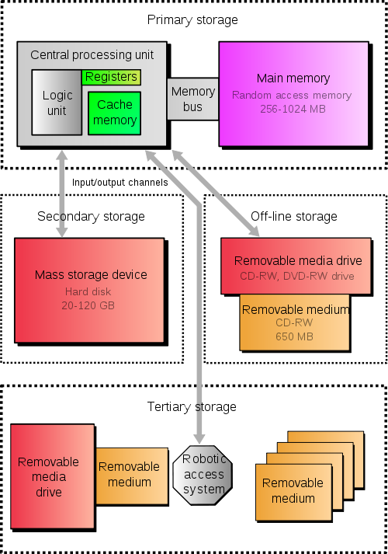

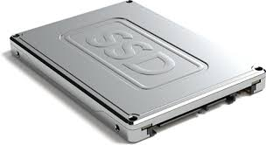
Type of storage (size)
1
3
RAM
CPU
Level 1
Level 2
2
HD
CD-DVD
4
5
Flash drive
SSD
7
Source: http://en.wikipedia.org/wiki/Computer_data_storage

Slide 6
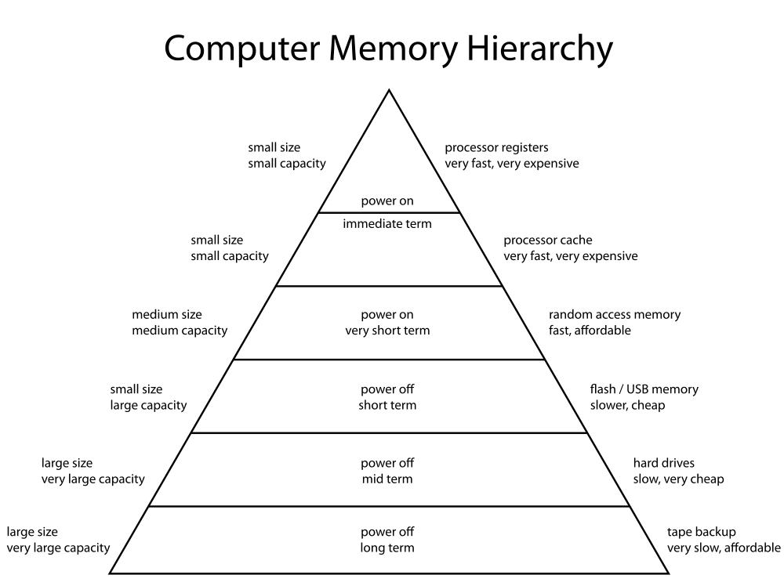
Computer Storage Hierarchy
size
Speed
1
2
3
4
Solid State Drive
5
6
7
Source: http://en.wikipedia.org/wiki/Computer_data_storage

Slide 7
Why back data?
Easy answer:
The world is not perfect
Hardware is not perfect
People are not perfect

Slide 8
Disaster type
Natural Disasters
You tell me what this means.
Unnatural Disasters
Again, what does this mean?

Slide 9
Natural Disasters
Weather
Flood
Fire
Lightning
Tornado
And all the structural things that break when a natural disaster happens.

Slide 10
Unnatural Disasters
Come in two basic categories:
Accidental
Intentional
Let’s think of some in each group…

Slide 11
Unnatural disasters – Accidental
I overwrote my assignment!
I deleted all my pictures!
I dropped my computer!
My drive is fried!
My little brother installed ____ and overwrote the entire hard drive!
I tripped on the power cord

Slide 12
Unnatural disasters – Intentional
Virus or other malware
My account was hacked!
My little brother installed ____ and overwrote the entire hard drive!
Someone stole/vandalized my laptop!

Slide 13
So why back up?
Lots of good reasons, but mostly…
…your data is important, at least to you

Slide 14
What should I back up?
Mostly it’s the data you care about.
Anything that can be easily reinstalled is usually not worth backing up
Remember about software settings and configuration when you make a backup plan.
The windows “Registry” is a good example.

Slide 15
What should I back up?
On a Windows computer, you normally want to backup “My Documents”
Other OSes, have a similar place
Don’t forget about other directories or folders on your computer such as:
My Pictures, My Music, etc
Data on other hard drives
Data stored in non-standard places
Some software will create other folders on your hard drive to store application specific stuff.

Slide 16
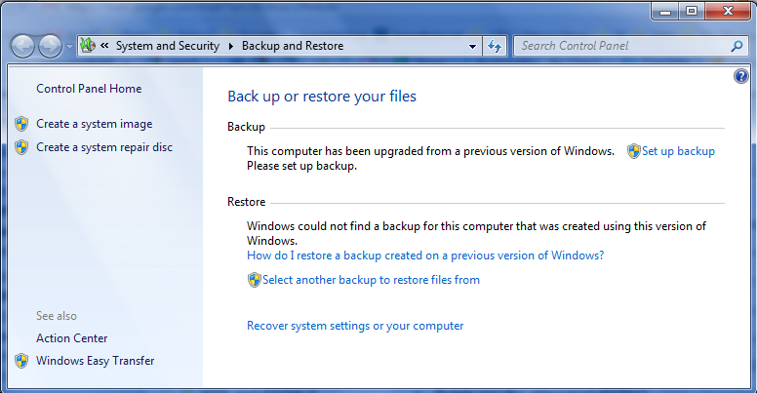
How do I back up my data?
Most OSes have some built-in software.

Slide 17
How do I back up my data?
If you are using the built-in, bundled or some other backup software, just follow the instructions.
Other methods generally involve copying the individual files yourself.
Sometimes you will create an “archive” or “zip” of a number of files first.

Slide 18
How do I back up my data?
“Proper” backups involve making multiple backups on a schedule.
“Proper” backups are automatic.
“Proper” backups are not all in one place.

Slide 19
Different types of Backups
Backups can be:
Images
Full
Incremental or Differential
Unstructured or “one-off”

Slide 20
Image backup
Image backup
An image backup is a full backup of the entire structure of the hard drive. Norton Ghost, Paragon
Often used to replicate software, settings and data.
Usually depends on source media and target media being similar.

Slide 21
Full backup
Full
A full backup is a complete byte copy of the target data.
This type does not depend on any other backup.
This type does not depend on target restore media.

Slide 22
Incremental or Differential
Incremental:
often means only back up new or changed files based on the last backup.
Process:
Long time to restore data (full+ incremental files)
Differential:
often means only back up new or changed files based on the last full and differential backup.
Process:
Quick to restore data (full +last differential)

Slide 23
Incremental or Differential
Terms are often used interchangeably.
Stores just the difference or incremental changes since the last full or incremental/differential backup.
It can be on a byte or file basis.

Slide 24
Incremental Backup
Mon Tues Wed Thurs Fri.
Full (50) N+C(20) N+C(18) N+C(16) N+C(27)
Daily BU 5+15 8+10 10+6 15+12
Advantage:
Faster daily back up(Tues, Wed, Thurs, Fri)
Disadvantage: longer to restore
C= Changed file N= New file

Slide 25
Differential Backup (ccumulative)
Mon Tues Wed Thurs Fri.
Full (50) N+C(20) N+C(28) N+C(30) N+C(35) 5+15 5+8+15 5+8+2+15 5+8+ 2+5+15
Advantage:
Faster to restore (Monday + Friday)
Disadvantage: Longer daily back up
C= Changed N= New Un=unchanged
cumulative

Slide 26
Incremental or Differential?
Incremental backups take less time to acquire the data.
Incremental backups take longer to restore.
Incremental backups require all the incremental backups since the last full backup and the last full backup to fully restore your data

Slide 27
Incremental or Differential?
Differential backups take more time to acquire the data.
Differential backups take less time to restore.
Differential backups require only the last differential backup and the full backup to fully restore your data

Slide 28
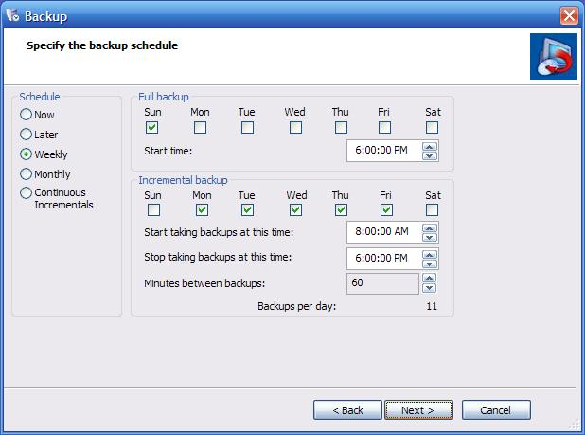
Different types of Backups Windows XP
Incremental or Differential schedule
Image source: http://www.storagecraft.com/blog/tag/desktop-backup/

Slide 29
Unstructured or “one-off” backup
Never automatic.
The target storage will change depending on circumstance.
Usually used for one file or one folder.

Slide 30
So, where do I back it up?
If you are using a backup application, the software will usually allow you to specify a backup location.
What are some places you would want to keep you backed up data?

Slide 31
So, where do I back it up?
Some places to keep a backup:
Another computer(server or workstation)
On a USB flash drive or removable hard drive
Email (Yes, I often email myself data!)
In the “cloud”
CD/DVD
Tape files
Drop box, skydrive

Slide 32
So, where do I back it up?
It’s generally best to keep important data backups in more than one place.
It’s generally best to have multiple versions of data backups.

Slide 33
So I have a backup, how do I restore?
Usually with the program you used to back up your data.
If your backup format/file structure is not proprietary, you can generally restore data using a different tool than was used to create the backup.
You can also restore to a different computer or different OS

Slide 34
Restore
If you used a backup/restore application, you would normally use that product to restore your data.
The target is limited by the hardware support of the application.
Usually with the program you used to back up your data.

Slide 35
Windows Vista and 7
Backup and Recovery
Microsoft Windows Vista and 7, 10 have a “System Restore” feature.
You can use this to restore your computer software and settings to an earlier point in time. User data is not backed up or restored.

